Slide 1

App User Manual
By: Muhammad Irteza Asif
And Areeba Asif
Notes:
Preworks course home assignments

Slide 2
Table of Contents
We're diving into Twitter Sentiment Analysis because we want to understand how people feel about things on Twitter. By looking at tweets, we can figure out if people are happy, sad, or neutral about different topics. This helps us make smarter decisions and connect better with others online.

Slide 3
Acknowledgements
A sincere thanks to my parents, mentors, Mr. Ken, group members, friends, and helpful websites for supporting my journey in App Development. Your support has been greatly appreciated.

Slide 4
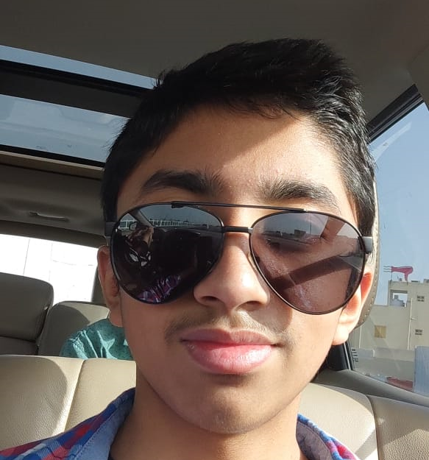
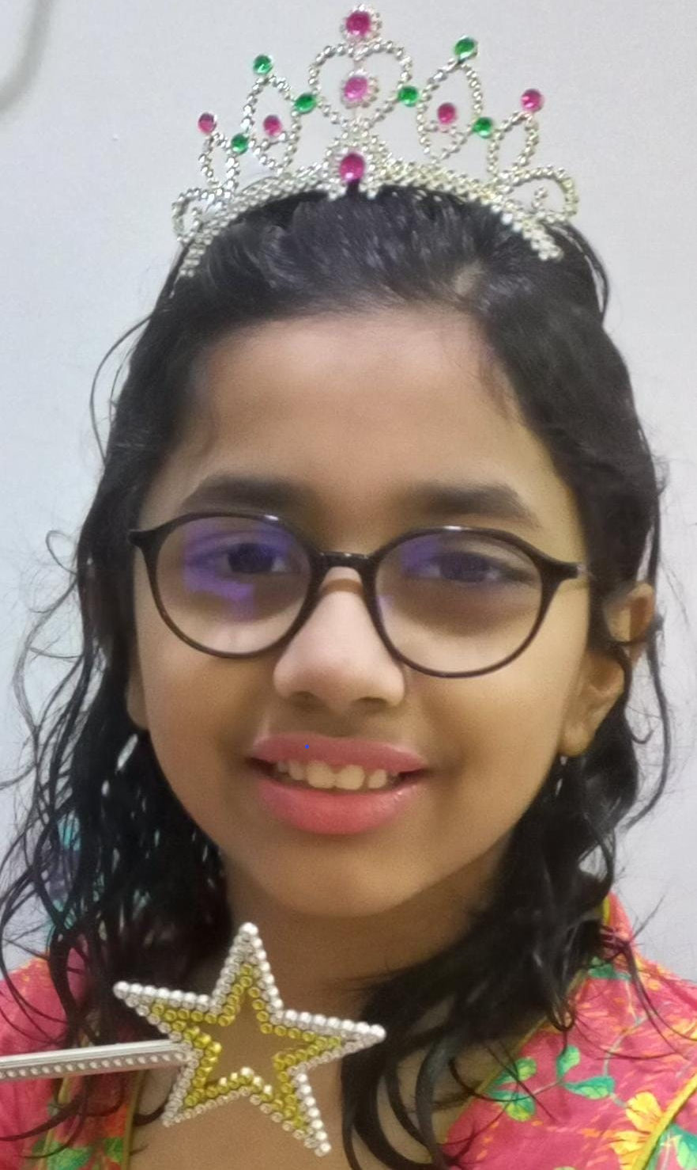
About Us..
Student’s Photograph
Student’s Introduction
Muhammad Irteza Asif my age is 14 and I'm in 10th grade
Areeba Asif my age is 10 and I'm in 6th grade

Slide 5
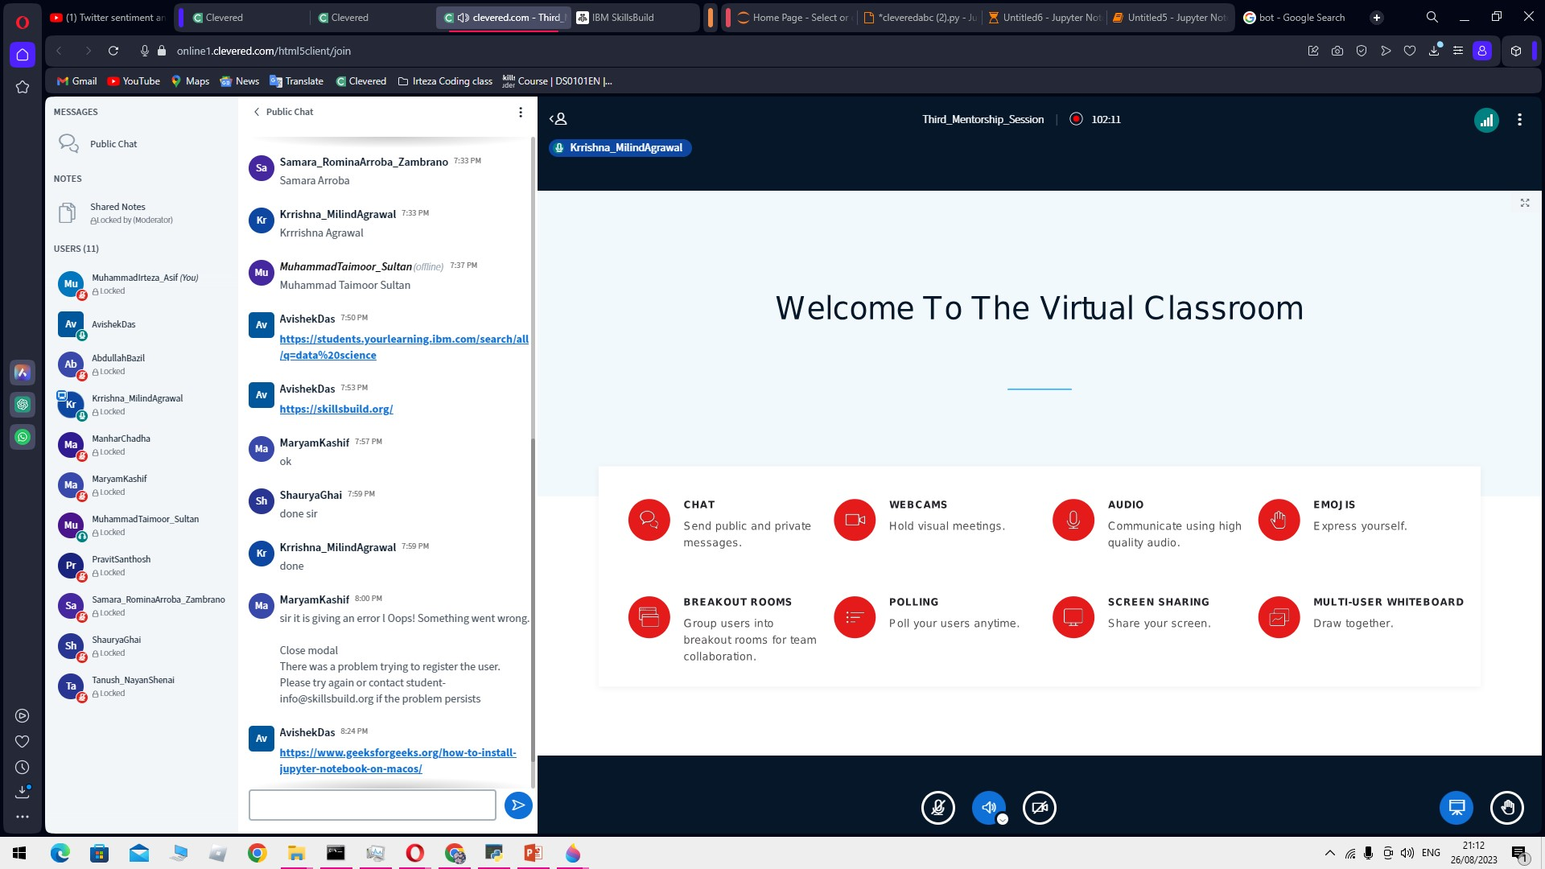
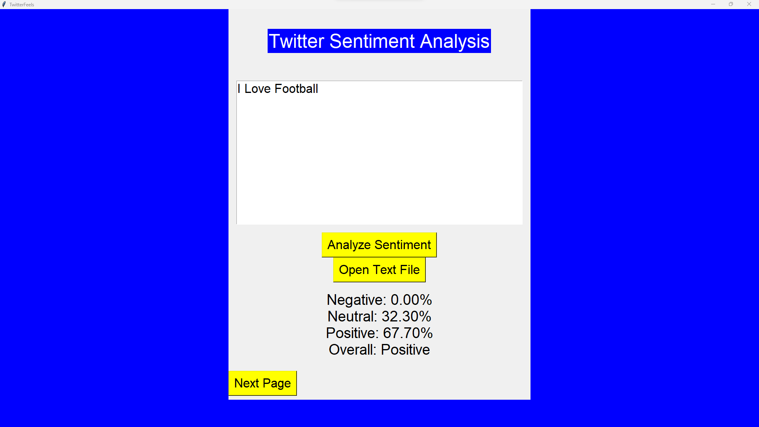
About My Internship Journey with Clevered..
Any photographs from sessions etc.
Our Internship Experience with Clevered
It’s Great we both are having a lot of fun

Slide 6
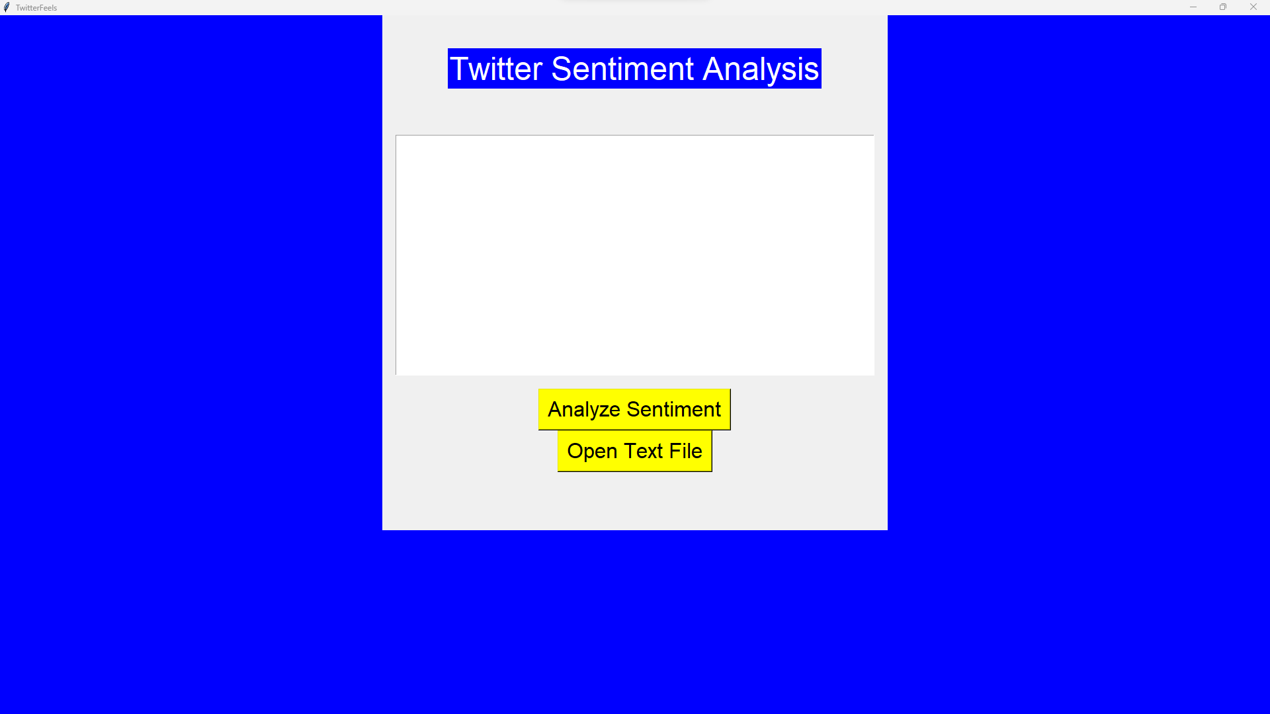
About App..
App’s Main Menu
App’s Introduction
Our app specializes in Twitter sentiment analysis. If you type negative expressions like 'I hate,' it recognizes it as negative. Positive phrases like 'I like games' are identified as positive. And neutral statements like 'I play football' are considered neutral.

Slide 7
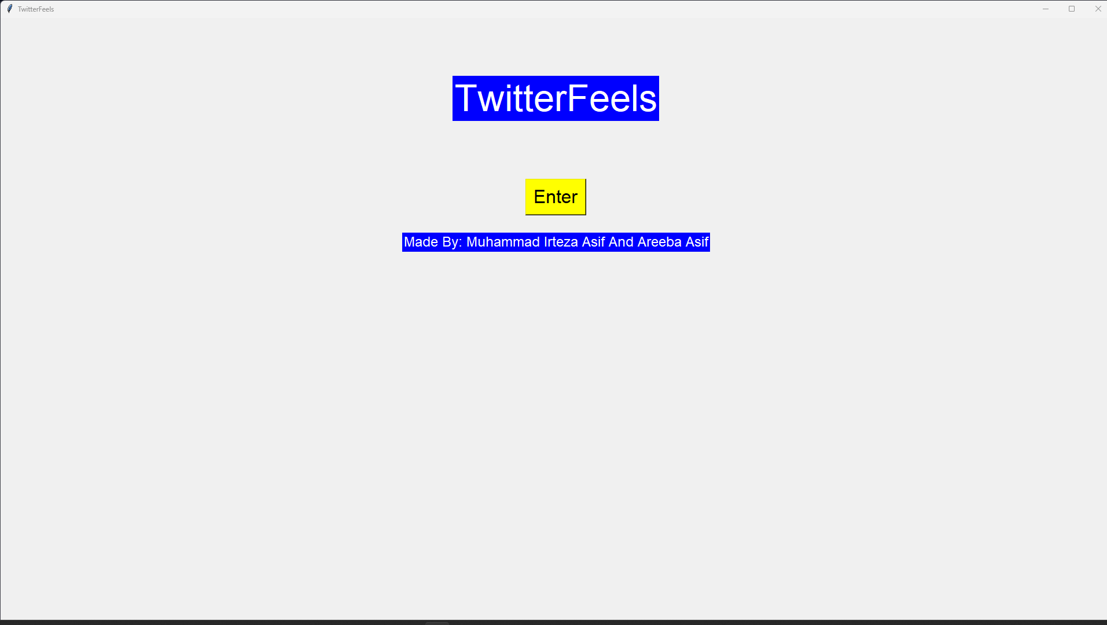
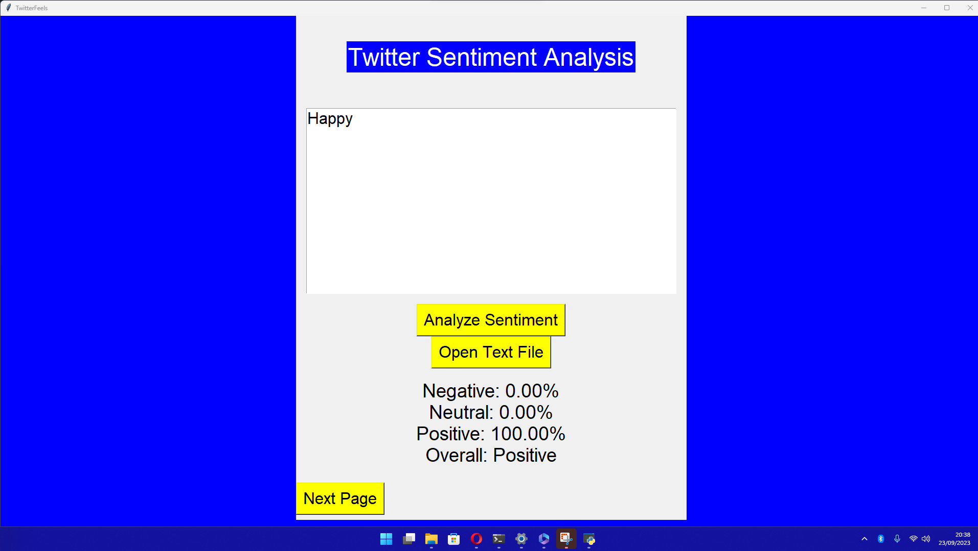
How do I use the App?
**TwitterFeels: Quick Guide** **Step 5: Finish**
- Click "Done" to exit.
**Step 1: Launch**
- Open TwitterFeels app.
-Press the enter button
**Step 2: Enter Text**
- Type or load text.
- Click "Analyze."
**Step 3: View Results**
- See sentiment percentages.
- Check "Overall" sentiment.
**Step 4: Thank You**
- Click "Next Page."

Slide 8
Feel Mood
Screenshot/ Pic of each option/screen of the App
Steps to use the same
**Step 1: Launch**
- Open TwitterFeels app.
**Step 2: Enter Text**
- Type or load text.
- Click "Analyze."
**Step 3: View Results**
- See sentiment percentages.
- Check "Overall" sentiment.
**Step 4: Thank You**
- Click "Next Page."
Next press on done to close it

Slide 9
Contact Person
Please reach out to Email funwithirteza@gmail.com for any questions/ concerns/ suggestions on the App
Name: Muhammad Irteza Asif

Slide 10
Thank you!

